Slide 1



Fundamentals of T-SQL Language
Eduardo Pivaral (MCSE, MCSA) – Dec 2019
SQL.Connect()
[Code].{Build}.Connect();

Slide 2







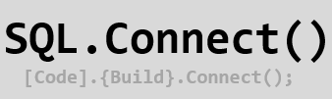
Gracias a nuestros patrocinadores

Slide 3





Eduardo Pivaral
Experience
+15 Years of experience working on IT
+10 Years of experience working with SQL Server
Developer of Open Source tools for SQL Server administration, development and productivity.
Certifications
SQL Server Database Consultant @ Pythian
MCSE Data Management and Analytics
MCSA SQL 2016 Database Development
MCSA SQL 2016 Database Administration
MCSA SQL 2012/2014
www.sqlguatemala.com
Eduardo Pivaral
Community
Regular Author for MSSQLTips.com
Regular Author for SQLServerCentral.com
MSSQLTips.com Rookie of the year 2018
Board member of Guatemala SQL Server User Group
Owner of SQLGuatemala.com
@EduardoDBA
Epivaral

Slide 4

AGENDA
How SQL Server engine works?
Working with data
Advanced T-SQL
DEMOS

Slide 5

How SQL Server Engine Works?

Slide 6
T-SQL: Is the Microsoft implementation for Standard SQL language
T-SQL
Transact-SQL
SQL
Structured Query Language
Relational Calculus

Slide 7
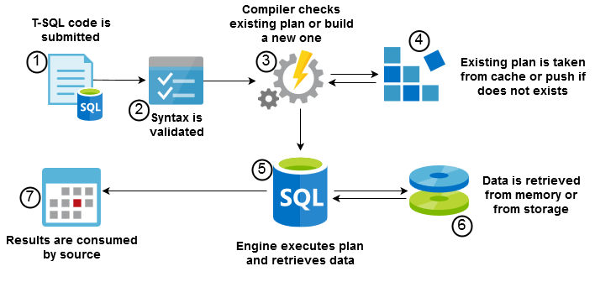
T-SQL is a Declarative Language: We instruct WHAT to do, engine decides HOW to do it.

Slide 8
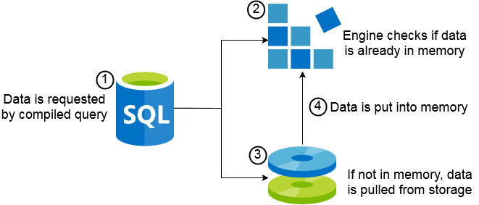
Check data in memory:
SELECT * FROM sys.dm_os_buffer_descriptors;
Clear data from cache (data will be pulled from storage again):
DBCC DROPCLEANBUFFERS;

Slide 9
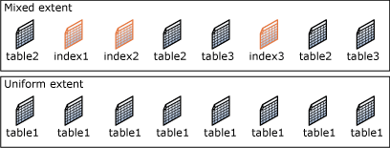
Page: The fundamental unit of data storage
Size is 8-KB
128 pages per megabyte
Extent: Eight physically contiguous pages
64 KB
16 extents per megabyte
Page activity from disk or memory on any T-SQL sentence:
SET STATISTICS IO ON;
New DMF on SQL Server 2019!!
sys.dm_db_page_info(DBId, FileId, PageId, Mode)

Slide 10
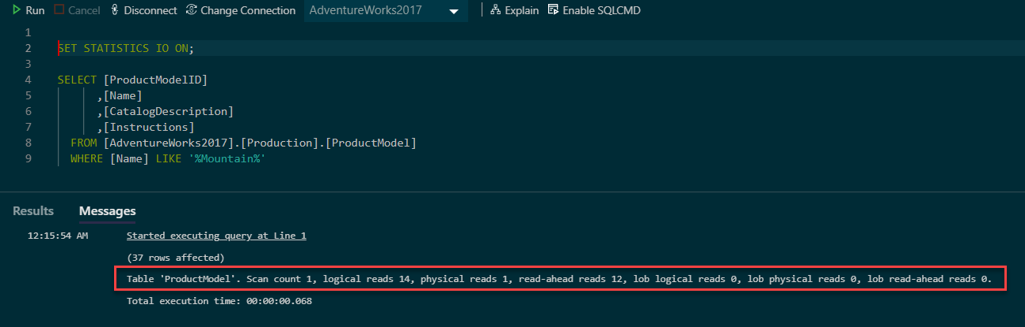
Read-ahead anticipates the data and index pages needed to fulfill a query execution plan and brings the pages into the buffer cache before they are used by the query.
More Info: https://docs.microsoft.com/en-us/sql/relational-databases/pages-and-extents-architecture-guide

Slide 11
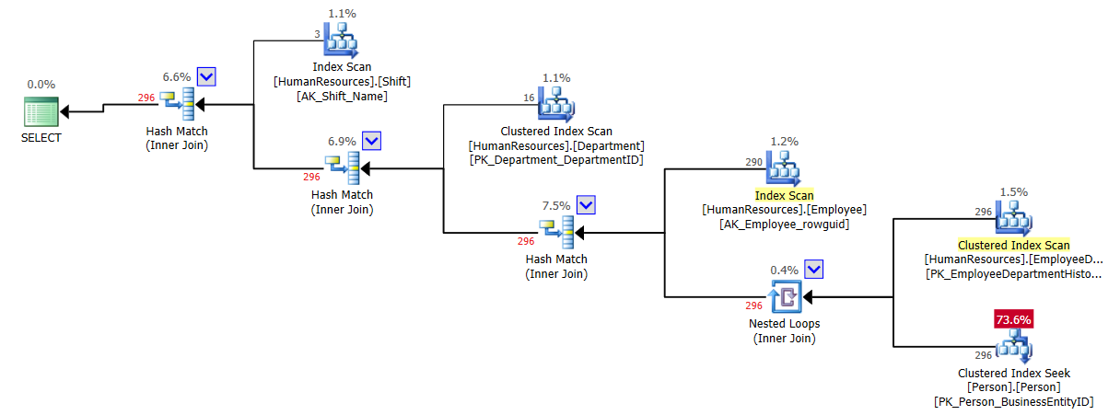
Execution plans: our way to debug code
Are the results of SQL declarative language
It is a calculation of most efficient way to execute a query
For poor performing queries, it should be the first thing to check
Clear plan cache (all plans will be compiled again):
DBCC FREEPROCCACHE;

Slide 12

Working With Data

Slide 13

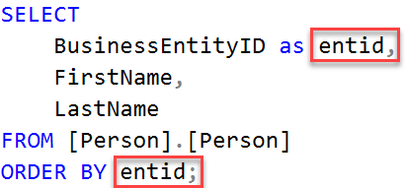
SELECT <Field list>
[FROM <Objects>]
[WHERE <row level filter>]
[GROUP BY <grouping>]
[HAVING <aggregation level filter>]
[ORDER BY <field list>];
Logical query processing
FROM
ON
JOIN
WHERE
GROUP BY
WITH CUBE or WITH ROLLUP
HAVING
SELECT
DISTINCT
ORDER BY
TOP

Slide 14
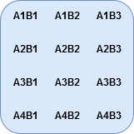
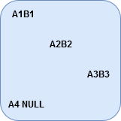
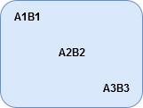
SELECT A FROM X
UNION [ALL]
SELECT B FROM Y
SELECT A FROM X
INTERSECT
SELECT B FROM Y
SELECT A FROM X
EXCEPT
SELECT B FROM Y
SELECT X.A, Y.B
FROM X INNER JOIN Y
ON X.A = Y.B
SELECT X.A, Y.B
FROM X LEFT OUTER JOIN Y
ON X.A = Y.B
SELECT X.A, Y.B
FROM X CROSS JOIN Y

Slide 15


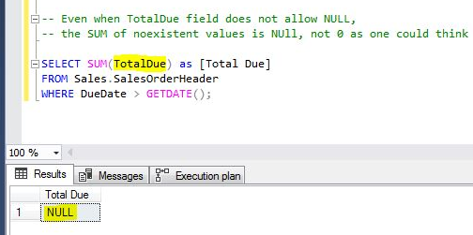
Grouping functions:
GROUP BY
OVER PARTITION BY
OVER ORDER BY
OVER ROWS
OVER RANGE
GROUPING SETS
NULL
NULL
COUNT(field) <= COUNT(*)
Be careful with aggregations over non-existent data

Slide 16
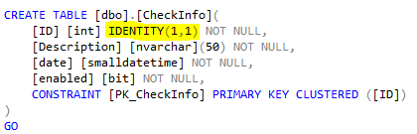
INSERT
INSERT INTO
INSERT SELECT
INSERT EXEC
SELECT INTO
UPDATE
UPDATE VALUES
UPDATE FROM
DELETE
DELETE WHERE
DELETE FROM
TRUNCATE TABLE
MERGE
MERGE INTO
WHEN MATCHED
WHEN NOT MATCHED
WHEN NOT MATCHED BY SOURCE
IDENTITY auto generate sequential numbers (ideal for primary keys)
Allowing Identity Insert:
SET IDENTITY_INSERT <table_name> ON;
OUTPUT allows you to watch modified rows info:
OUTPUT inserted.[field] -- Inserted or after update data
OUTPUT deleted.[field] -- Deleted or before update data

Slide 17
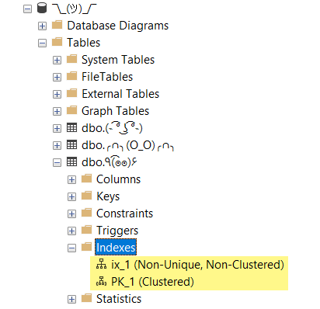
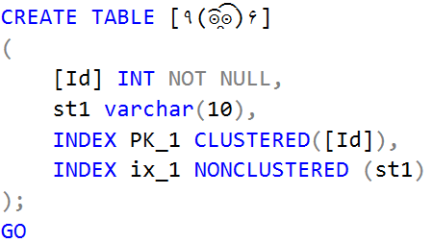
Inline index creation:

Slide 18

Advanced T-SQL

Slide 19
Programmability Object
Syntax
SELECT
X
.
a
Subqueries
FROM
(
SELECT
i
as
a
FROM
Table1 X
);
WITH
[
name_CTE
]
Common Table Expressions
AS
(
SELECT
a
,
b
FROM
TableA
)
SELECT
I
.
a
,
I
.
b
FROM
[
name_CTE
]
;
CREATE
PROCEDURE
[
Proc_name
]
@param1
int
=
0
Stored Procedures
AS
SELECT
@param1
RETURN
0
;

Slide 20
Programmability Object
Syntax
CREATE
FUNCTION
[
FunctionName
User Defined Functions (UDF)
]
•
Scalar
(
Inline (Table valued)
@param1
int
•
)
Multi
-
•
statement (Table valued)
RETURNS
…
SELECT
X
CROSS APPLY
.*,
CA
.*
OUTER APPLY
FROM
X
[CROSS|OUTER]
APPLY
f
(
X
.
a
)
CA
;

Slide 21



Temporary tables
Remarks
Session Scoped temporary table, resides in tempdb
#Table1
Affected by transactions
Global temporary table,
resides in tempdb
##Table1
Affected by transactions
Table variable, only resides into memory
@Table1
Not affected by transactions

Slide 22

ACID – Set of properties to guarantee data validity
Atomicity: each transaction is treated as a single unit of work
Consistency: any data written must be valid according to defined rules
Isolation: concurrent executions must not interfere with each other
Durability: once a transaction is commited, it will stay on that state

Slide 23

SET TRANSACTION ISOLATION LEVEL <OPTION>;
Isolation Levels
Transaction Syntax | Description
BEGIN TRANSACTION; | Starts explicit transaction. Increment @@TRANCOUNT in 1
COMMIT TRANSACTION; | Commits explicit transaction. Decrement @@TRANCOUNT in 1
ROLLBACK TRANSACTION; | Rollbacks explicit transaction. Decrement @@TRANCOUNT in 1
Isolation
Serializable
Repeatable Read
*Read Committed
Read Uncommitted
Pessimistic
Autocommit Transactions: By statement and controlled by engine automatically.
If an error occurs or session is cancelled, the sentence is rolled back
Concurrency
Optimistic

Slide 24

SQL Server Locks
Lock Mode | Description
Shared (S) | Operations do not modify data
Update (U) | Operations could modify data
Exclusive (X) | Operations are modifying data
Intent (IS, IX) | At compile moment, used to determine lock scalations
Schema (Sh-M, Sh-S) | Prevents schema modifications at execution or to ensure stability at compiling time
Bulk Update (BU) | Table locks for bulk operations
Lock Hierarchy
Database
Table
Page
Row
Deadlock: when concurrent sessions require exclusive lock to the same object, the least expensive operation is rolled back by engine.
Checking locks: sys.dm_tran_locks
Lock Escalation

Slide 25


Error Handling
It is a best practice to re-throw errors to client with custom messages, SQL Server have 2 functions for this:
BEGIN TRY
-- code to verify
END TRY
BEGIN CATCH
-- error handling block
-- error functions:
SELECT
ERROR_LINE(),
ERROR_MESSAGE(),
ERROR_NUMBER(),
ERROR_PROCEDURE(),
ERROR_SEVERITY(),
ERROR_STATE()
END CATCH;
Command | Description
THROW [Error_number],[Message],[State]; | *Recommended to use Fixed severity of 16 Always activates CATCH block
RAISERROR([Message],[Severity],[State]); | Supports log to Application Log Activates CATCH block for severity >10
TRY..CATCH does not capture compilation errors or errors by killed sessions.

Slide 26

DEMOS

Slide 27



SQL.Connect()
[Code].{Build}.Connect();
Thank you!
Want to know more? Having doubts about this presentation?
Visit me at:
www.SQLGuatemala.com
Eduardo Pivaral
@EduardoDBA
Epivaral

